Slide 1
Capstone Project
Medical Inventory System and Infrastructure
Prepared by: Thirumaal.T
Course taken: Cyber Security

Slide 2
Content
Designing a Network
Implementation of designed network
Service implementation and security deployment

Slide 3
Objective
Designing a network
In this project star topology is used, the design is reliable from start to end, the design is implemented to the requirement of the project, the design is cost effective.
Implementation
In implementation the designed network is implemented in GNS3 simulator. Dynamic routing, ACL, Internet connectivity are done in this stage.
Service implementation and Security deployment
There are some services and security required in the project, in webserver the nginx service and IDS Snort are deployed. In database mysql service and Kerberos are deployed. In every machine as additional proctection firewalld service are installed and configured.

Slide 4
Designing a Network

Slide 5
Design criteria
2 VPC’S (for each department)
5 Switches (Ethernet Switch)
1 Router
Cloud (Internet)
2 Firewall
1 Web server
1 Database server
Links – Ethernet Cable (CAT 6)

Slide 6
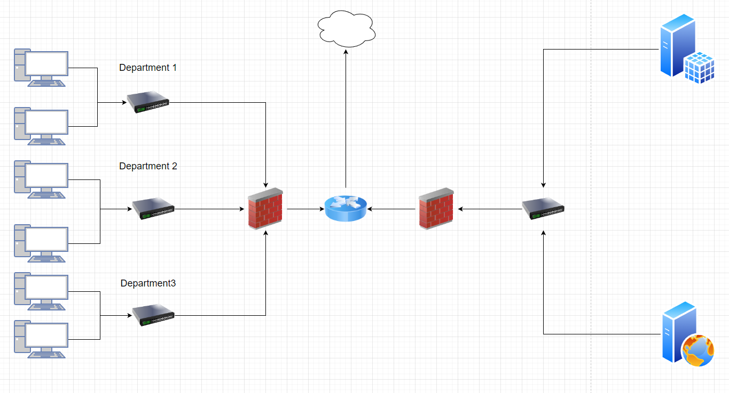
Network Design in draw.io

Slide 7
IP Implementation
The IP is segmented class C from 10.1.0.0/24.
For department 1 the IP network ID is 10.1.2.0/24.
For department 2 the IP network ID is 10.1.3.0/24.
For department 3 the IP network ID is 10.1.4.0/24.
For webserver IP is 10.1.5.10/24.
For database server IP is 10.1.5.20/24.
For R2 fa0/0 and R1 e1/0 network ID is 10.1.1.0/24

Slide 8
Techniques and Devices
Switches - connects devices on a computer network by using packet switching to receive and forward data to the destination device.
Router - A router is a networking device that forwards data packets between computer networks. Routers perform the traffic directing functions on the Internet.
Web server - The webserver is to host a front-end webpage of the hospital.
Database server - The database server is to save data’s, details of hospital and is it accessed by webpage.
Firewall - network security device that monitors and filters incoming and outgoing network.

Slide 9
Network Implementation

Slide 10
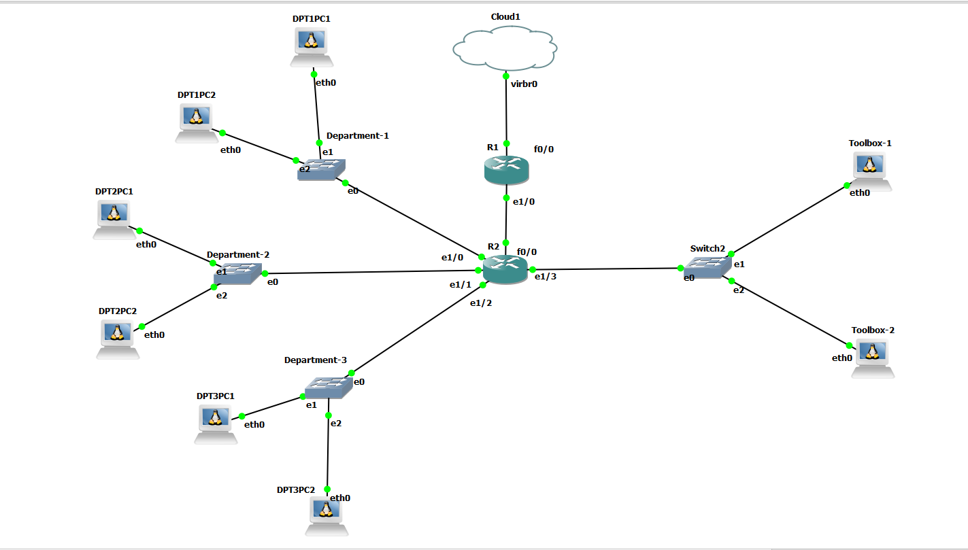
GNS3 Design

Slide 11
Router Configuration:
Assign IP
Dynamic routing
Internet Connection

Slide 12
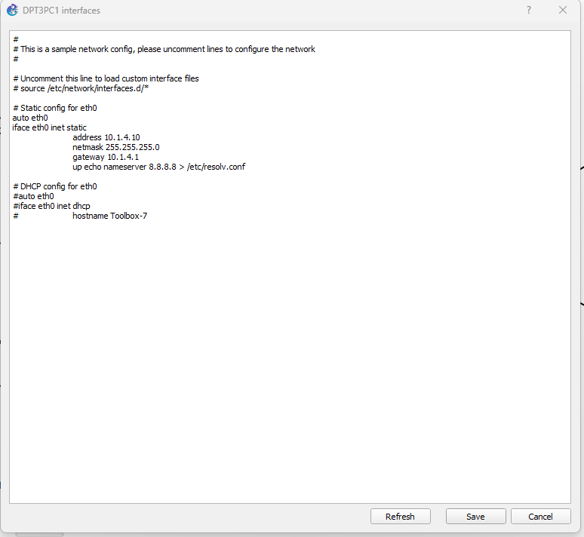
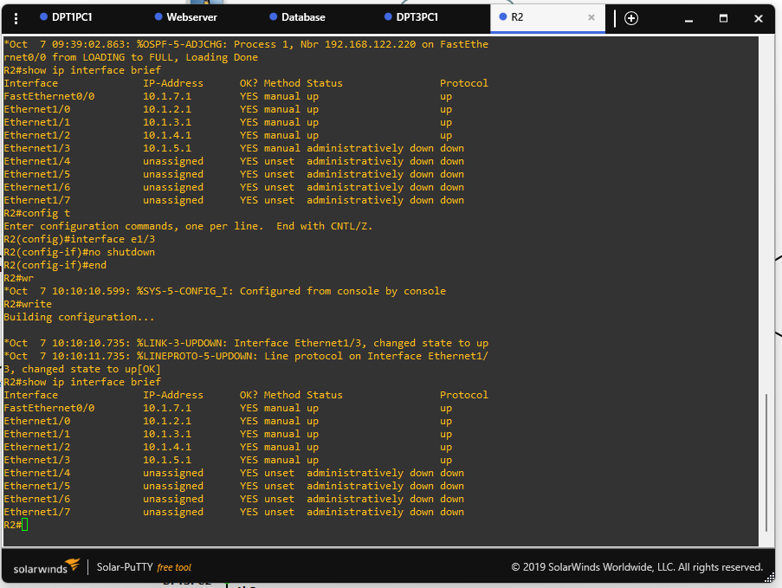
Assigning IP

Slide 13
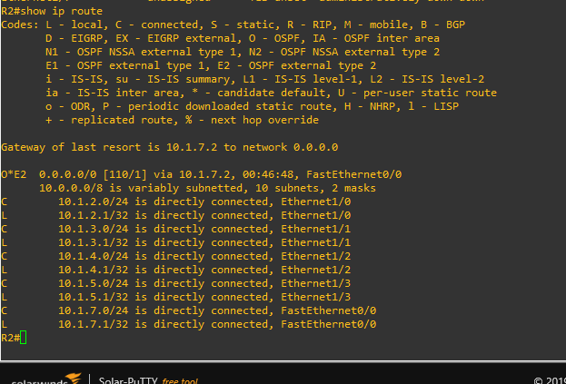
Dynamic Routing
For dynamic routing OSPF is used here

Slide 14
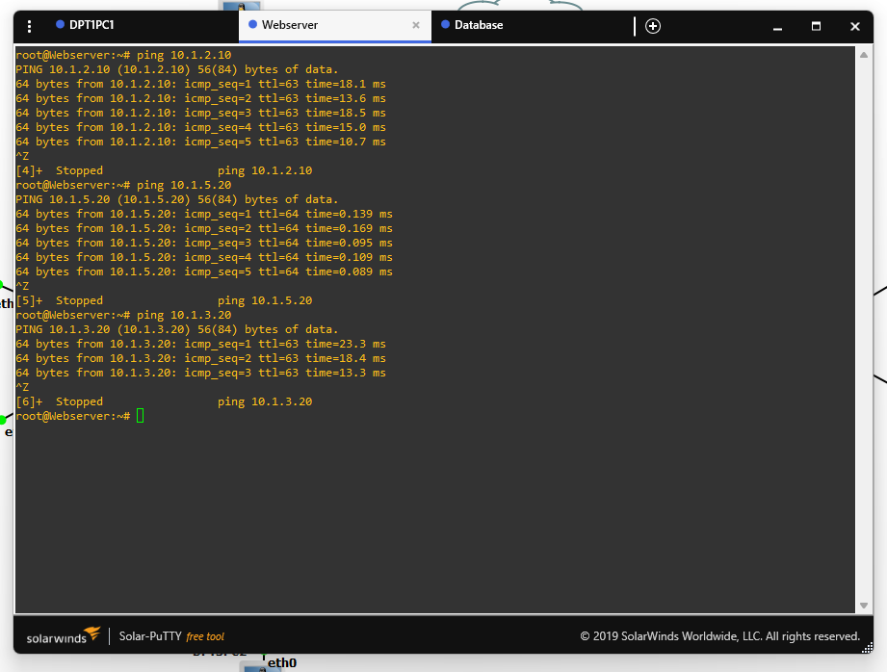
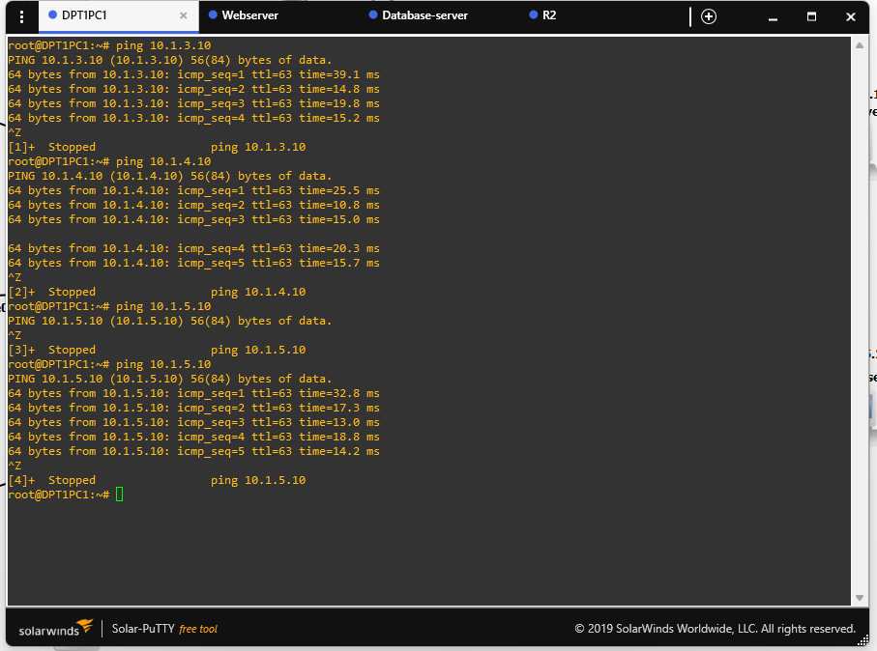
Ping from PC

Slide 15
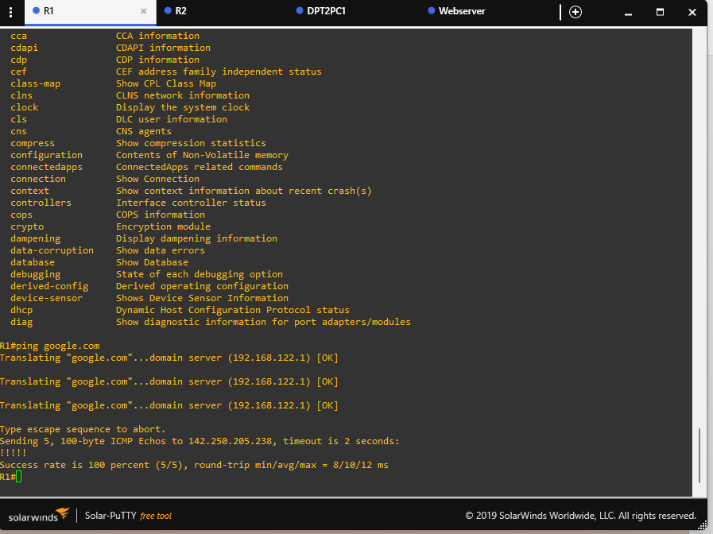
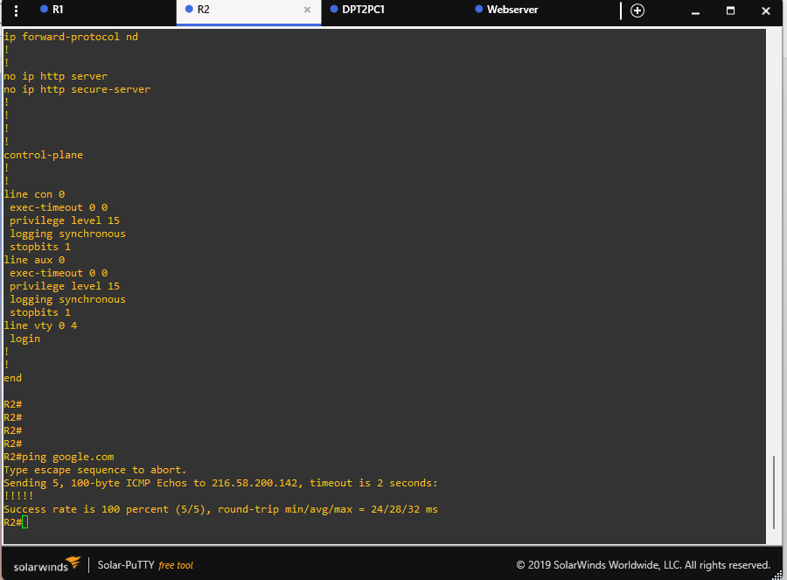
Internet Connectivity - ping from Router

Slide 16
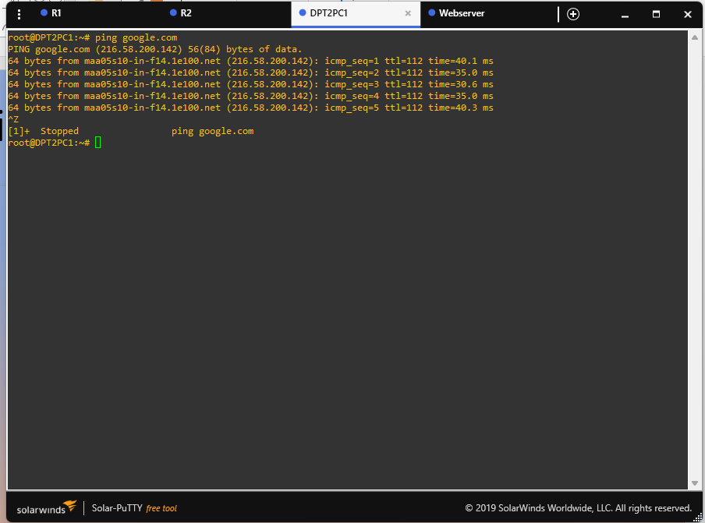
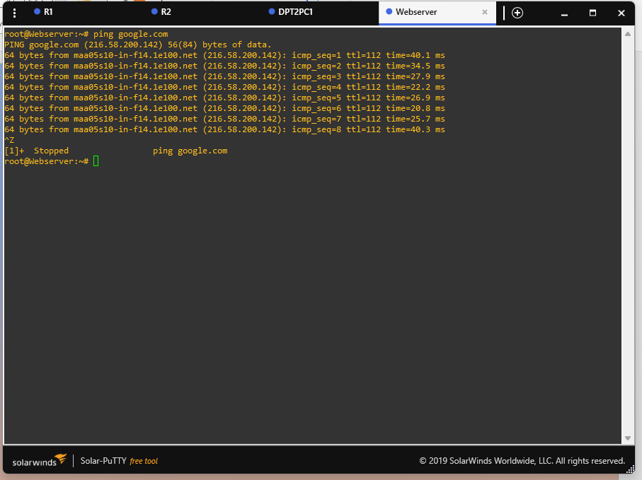
Internet Connectivity - ping from PC’s

Slide 17
Service implementation and Security deployment

Slide 18
Content
Services - nginx in webserver
mysql in database
Security – snort in webserver
Kerberos in database

Slide 19
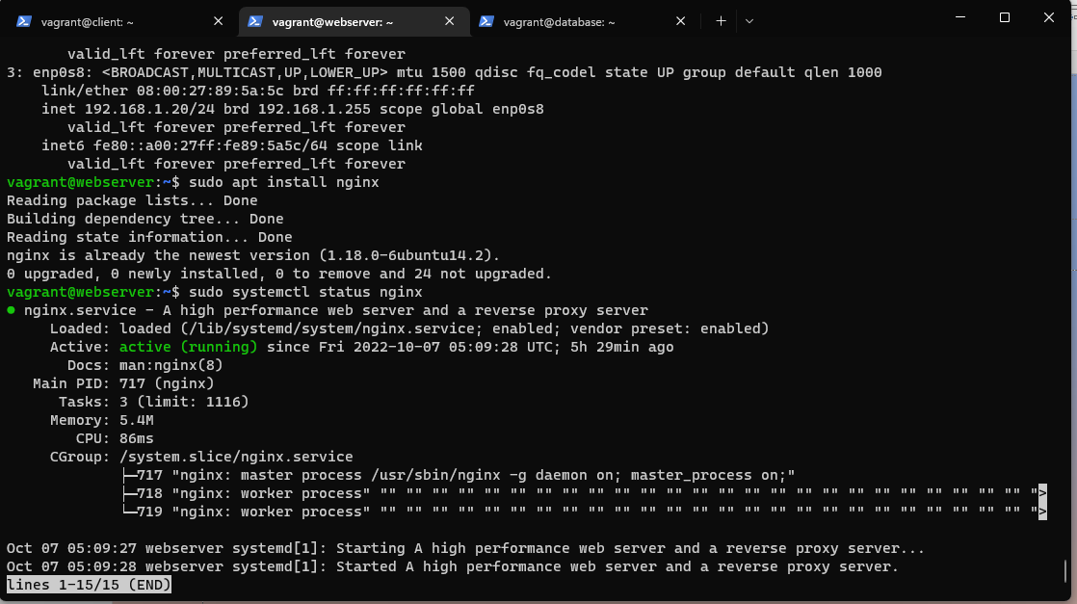
Webserver machine
Installing nginx and status.

Slide 20
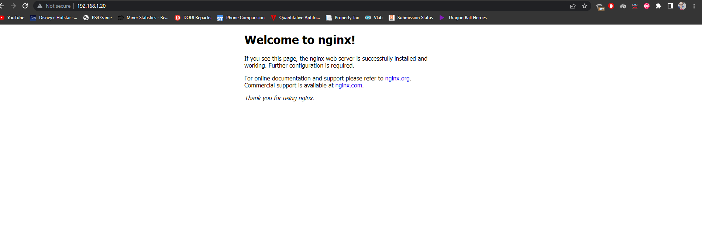
Accessing

Slide 21
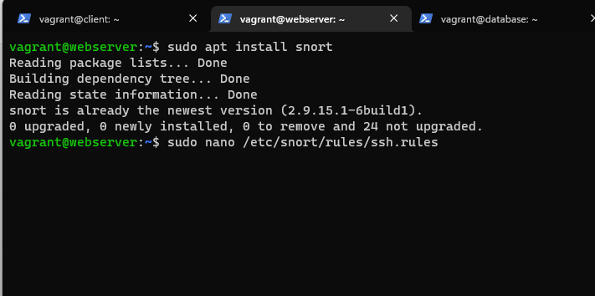
Snort
Snort installation

Slide 22
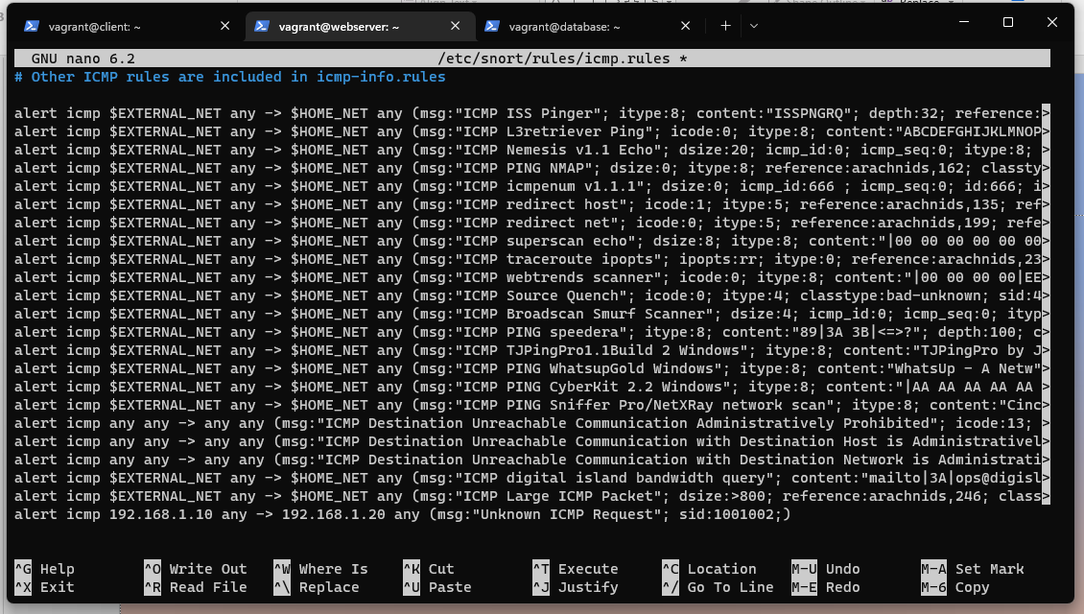
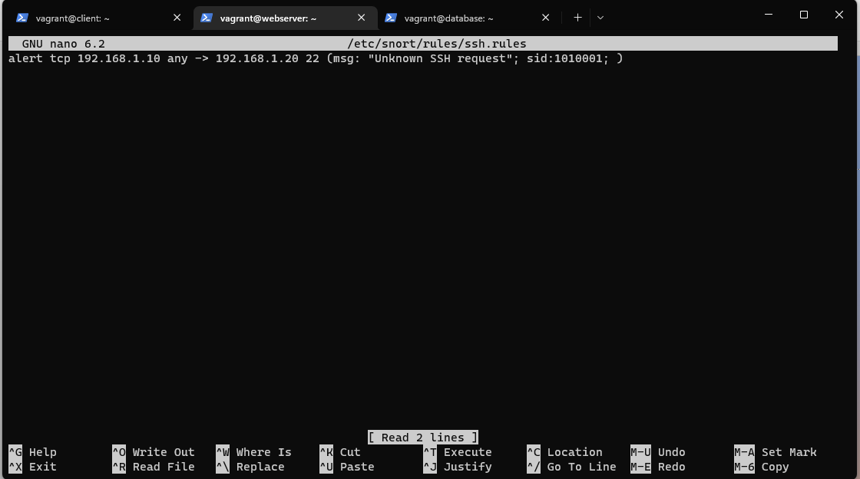
Snort ICMP rules and SSH rules

Slide 23
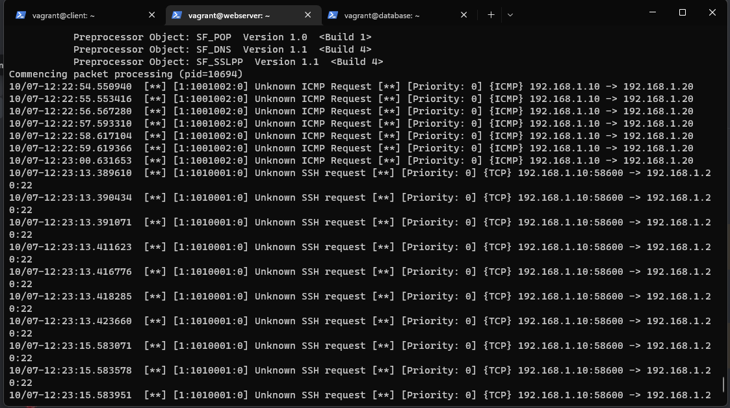
Logging

Slide 24
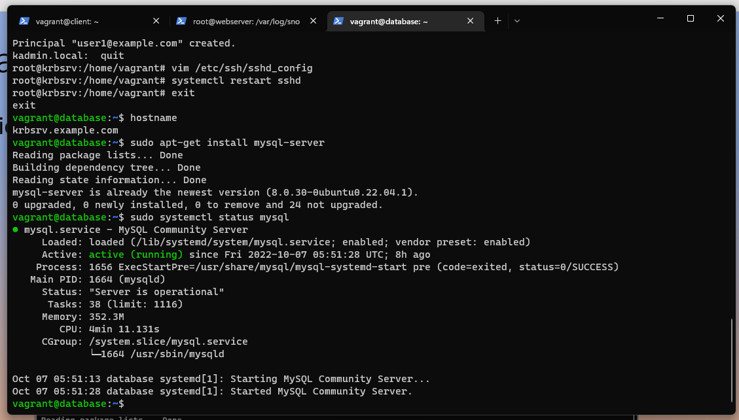
Database machine
Installation of mysql and status of mysql service running.

Slide 25
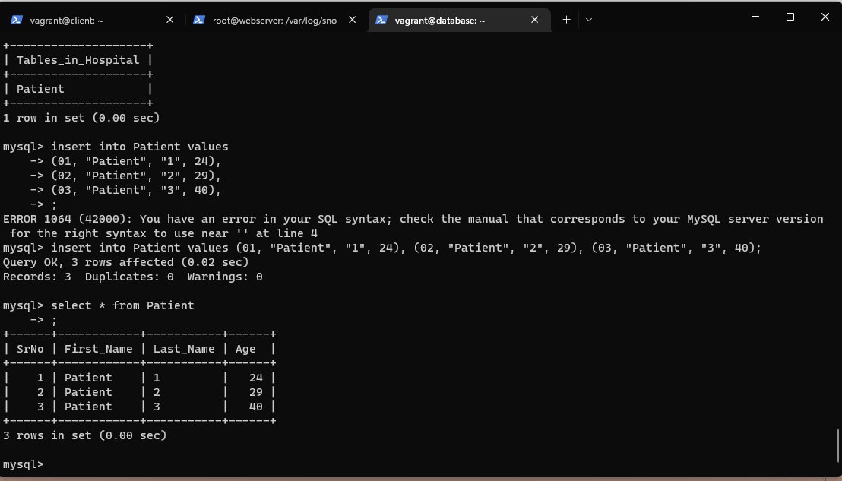
Database
Creating database, adding tables, adding values to tables.

Slide 26
Kerberos
In server Kerberos configuration
1. Changing host name
2. Installing Kerberos for server
3. Creating new realm
4. Adding new user
5. Generating Key.

Slide 27
Configuration Contd.
In client Kerberos configuration
1. Changing host name
2. Installing Kerberos for client
3. Generating Key
4. Adding user
5. Changing SSH configuration
6. Change into user and ssh is done login success.

Slide 28
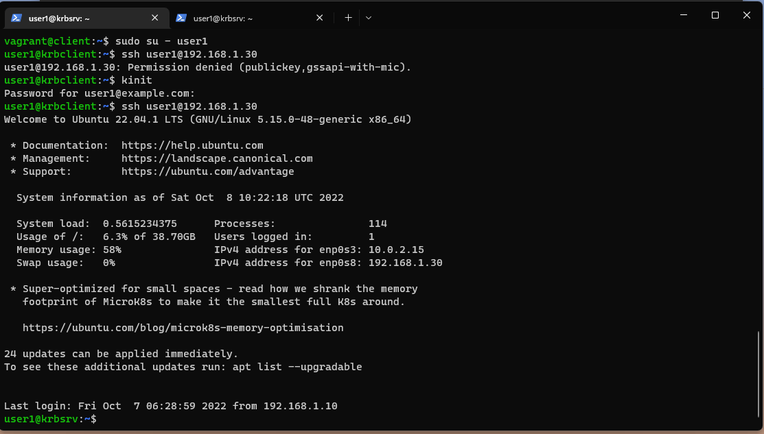
SSH login using Kerberos user

Slide 29
Thank you

